Slide 1


DS Capstone – Perfect location for Chinese Restaurant in Bangalore city
Rohan Gudisagar

Slide 2
Problem Background
With 42.12% of Greater Bengaluru’s population originating from outside the district or outside the State, the urban agglomeration ranks second among comparable metros with migrant populations.
Bangalore is known not only as the IT Sector, but also a foodie’s haven. The street food here is amazing, fulfilling, and available at budget friendly prices
The diversity of the cuisine available is reflective of the social and economic diversity of Bengaluru

Slide 3
Problem Description
Which are has more population?
Which area in the city has more facilities and stores, which will attract more crowd?
Are there any Chinese restaurants existing in the area?
Do the similar restaurants cost more?
Which area in the city has more venues? (making it suitable for the restaurant start up)
Which location in the city is densely populated

Slide 4
Data Requirements
Its geographical coordinates (latitude and longitude) of points in the city where there is a possibility of the restaurant to open
Population of the neighbourhood where the restaurant is located, which will produce more walk-ins at the restaurant

Slide 5
To access location of an area in the city, its Latitude and Longitude is to be known so that we can point at its coordinates and create a map displaying all the venues with its labels respectively.
Population of a neighbourhood is very important factor in determining a restaurant's growth and number of customers who turn up to eat. Logically, the more the population of a neighbourhood, the more people will be interested to walk openly into a restaurant and less the population, a smaller number of people frequently visit a restaurant. Also, if more people visit, better the restaurant is rated because it is accessed by different people with different taste. Hence is a very important factor.

Slide 6

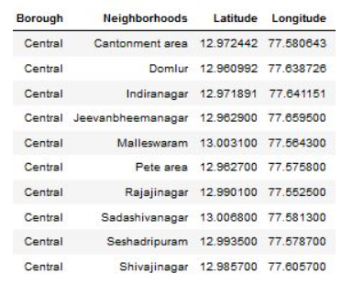
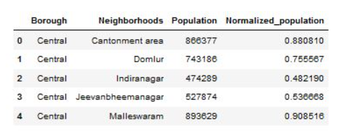
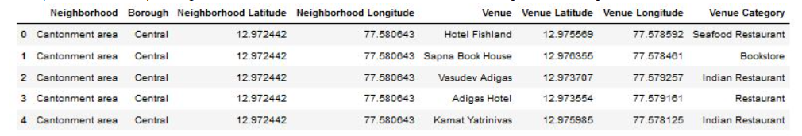
Data Collection

Slide 7
Target Audience
Target audiences for this project does not limit to a person who wants to open a specific restaurant in the area, but to anyone that’s working on any business idea. This project is open ended to anyone that want to explore the city of Bangalore.

Slide 8
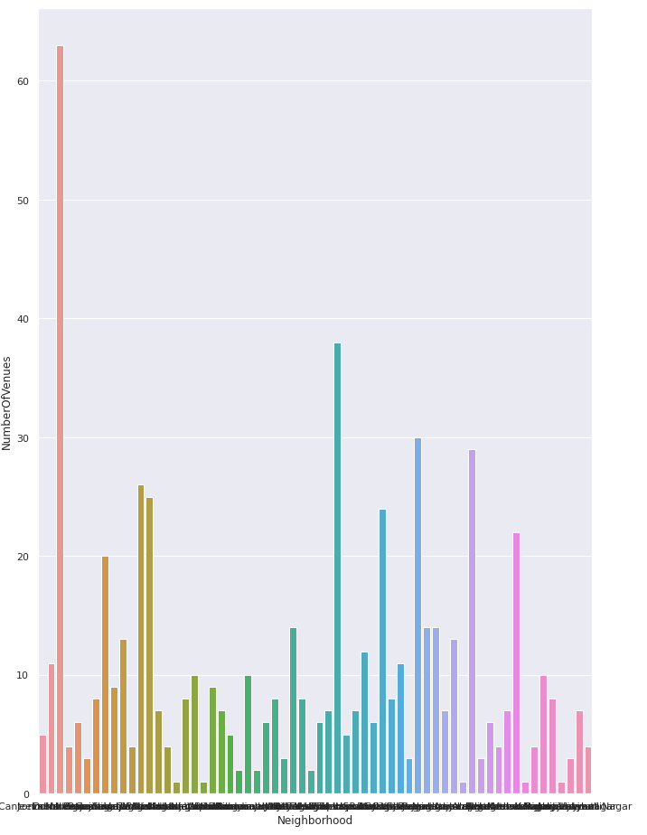
Methodology
Find the area with most venues

Slide 9
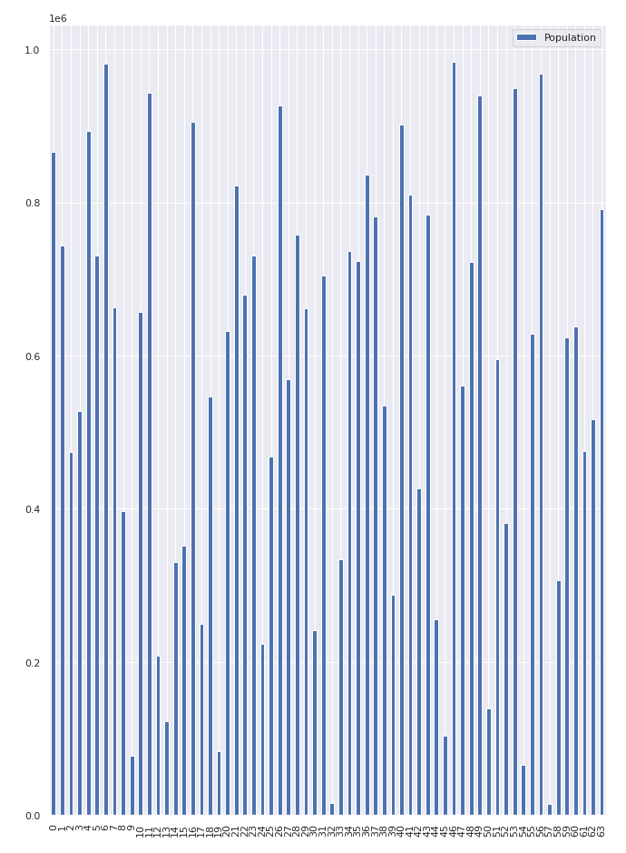
Find area with most population

Slide 10
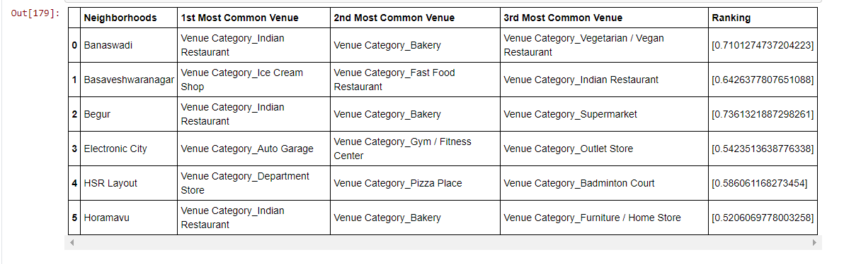
Result

